Slide 1
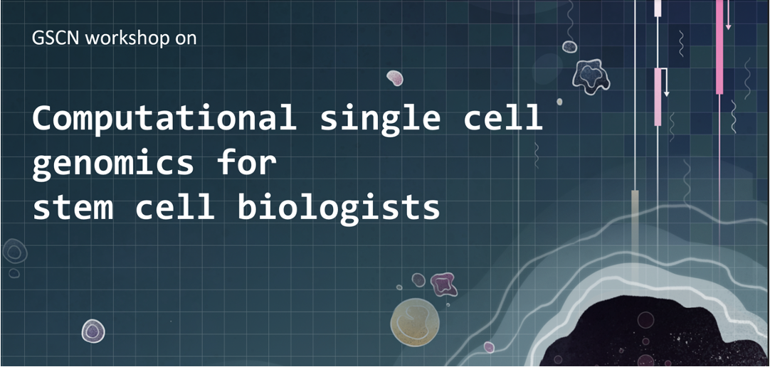
November 7 - 8

Slide 2






Computational single-cell genomics for stem cell biologists
Sara Jiménez
Machine learning group, CHC
November 8, 2024
sarajimenezc
sarajimenez

Slide 3
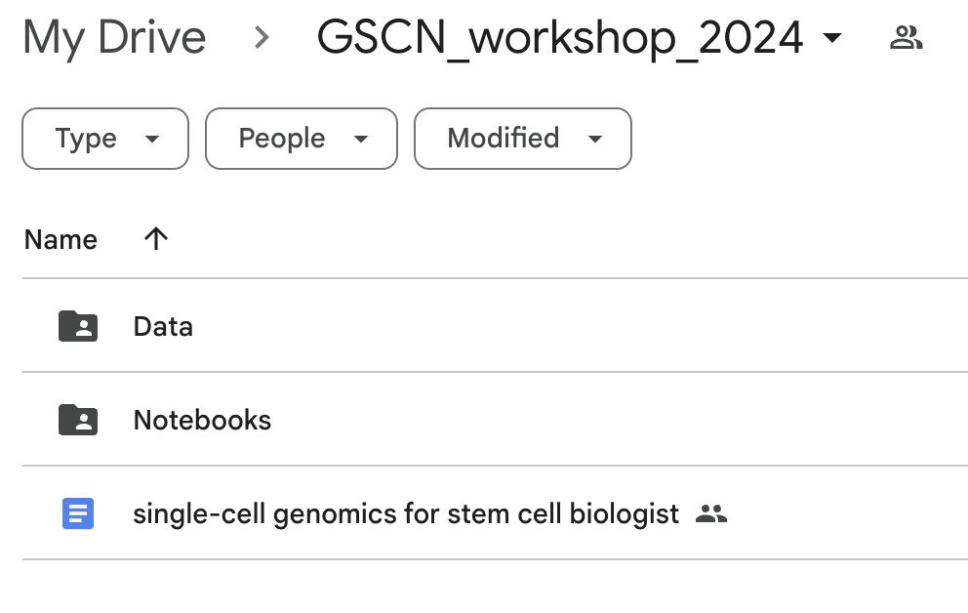
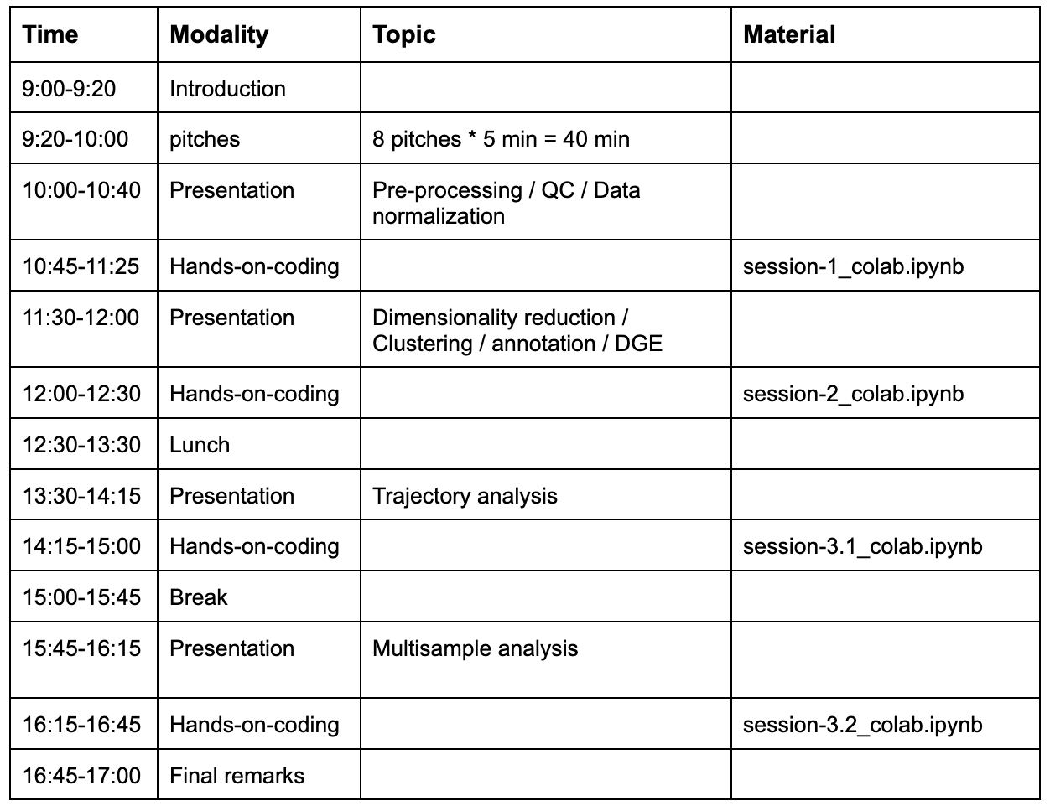
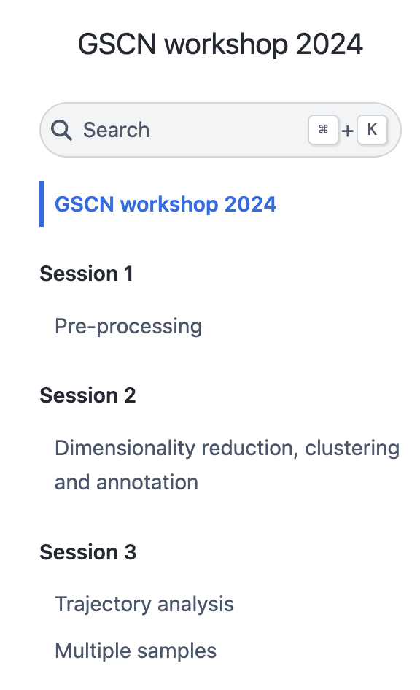
Overview of this workshop
✅
✅
✅
https://sarajimenez.github.io/GSCN_workshop_2024/
✅

Slide 4
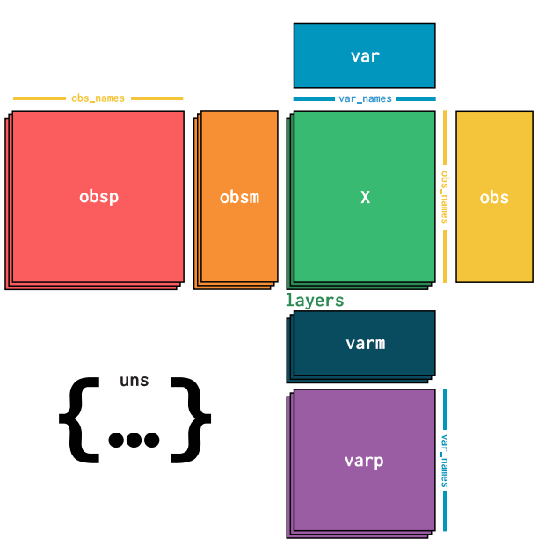
Recap: AnnData
X: the cell-by-gene data on which all computation will be done
obs: cell (observation) specific 1-dimensional information
obsm: cell (observation) specific m-dimensional information
var: gene (variable) specific 1-dimensional information
varm: gene (variable) specific m-dimensional information

Slide 5
Trajectory Inference
Notes:
So dimensions are the cellular features or parameters we measure (gene mRNA transcripts).

Slide 6
Trajectory Inference
Biological samples are not always composed of discrete/distinct cell types
The formation of cell types involves gradual changes in cellular phenotype from an initial cell type (progenitor) to the final cell type (differentiated)
Trajectory inference attempts to map the cells from one phenotype to another along a continuous axis (called pseudotime)
Biological samples are generally heterogeneous enough that a single snapshot of scRNA-seq data with sufficient cell number captures all the dynamics involved during such continuous changes
Goal: Capture gradual changes ==> requires us to understand locally similar cells ==> Graphs!

Slide 7
Approach 1: Diffusion Maps

Slide 8
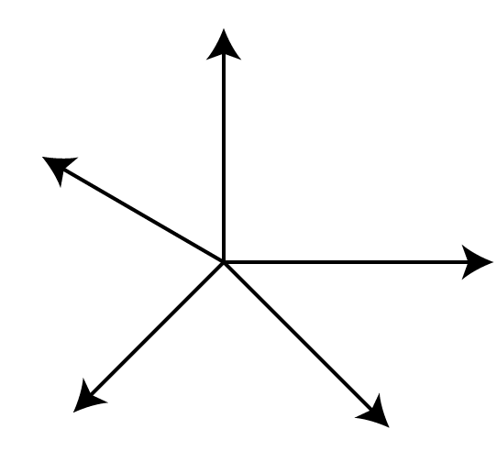
Diffusion Maps
Distances are cleaner, can do computation here
PCA2
Gene5
Gene4
PCA1
Gene1
PCA3
Gene2
Gene3
Not UMAP or tSNE or FDL because they are not distance preserving!
Signal too noise, distances not biologically accurate
Dim 2
Complex biological systems require further refining of distances/neighborhood of each cell (for example Jaccard metric)
Dim 1

Slide 9
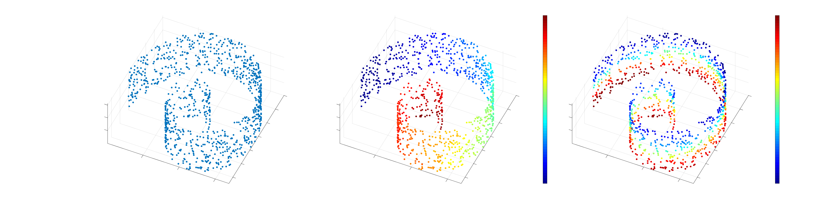
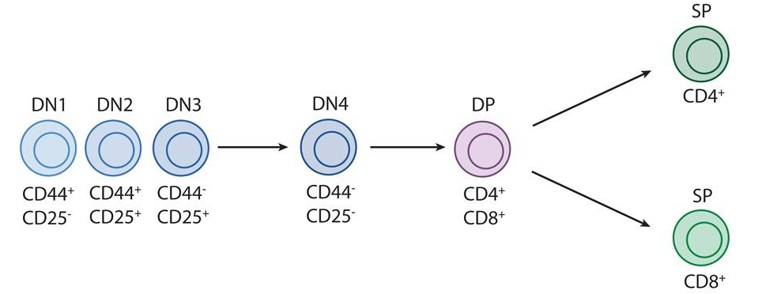
Diffusion Maps
Data
Colored by 1st diffusion component
Colored by 2nd diffusion component
Lafon and Coifman 2006, Nadler et. al. 2006, Setty et. al. 2016

Slide 10
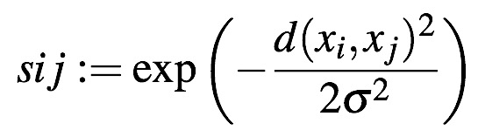
Transition matrix -> Diffusion components
Distance Matrix
Distance -> Similarity via Kernel
Cell
Cell
Transition Matrix
Affinity Matrix
Eigen-Vectors provide an optimal embedding that preserves local high-dimensional geometry along directions of highest variance
Row-normalize affinity matrix, so that each row sums to 1
Notes:
Can interpret every entry of the resulting matrix as the transition probability of a random walker.

Slide 11
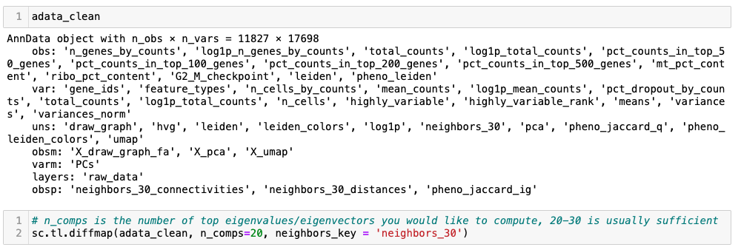
Diffusion Maps

Slide 12
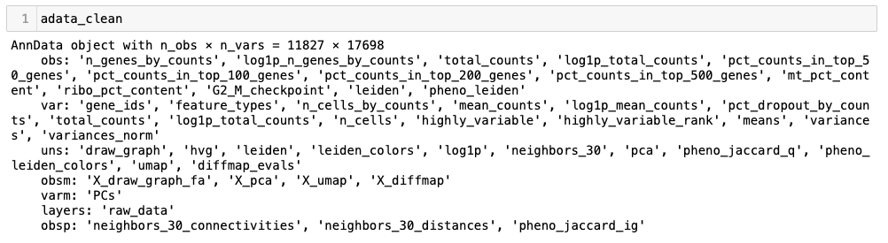
Diffusion Maps
 | Evalue
Evec0
Evec1
…
EvecK
 | EVec0 | Evec1 | … | EvecK
Cell1
Cell2
…
CellN

Slide 13
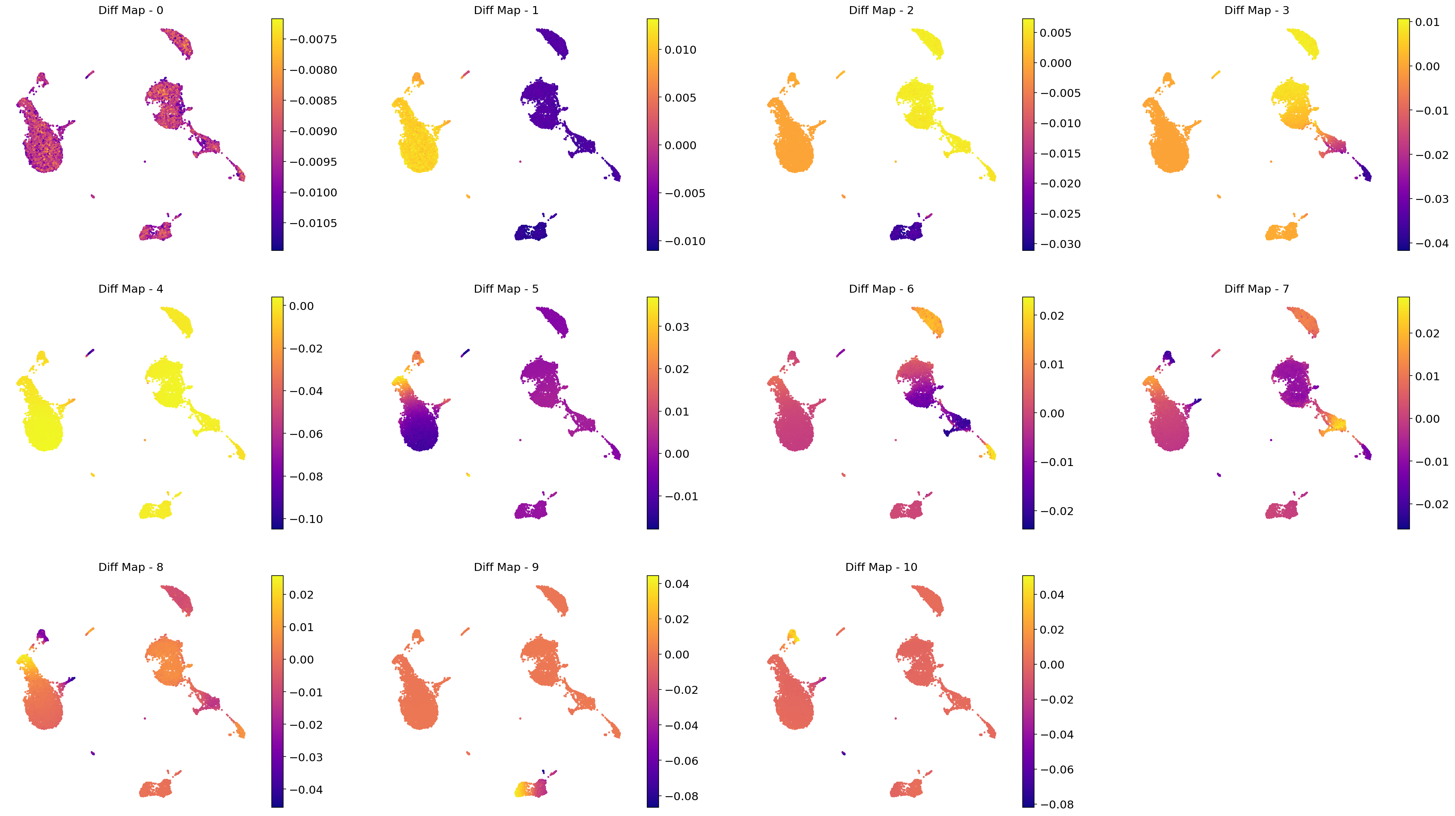
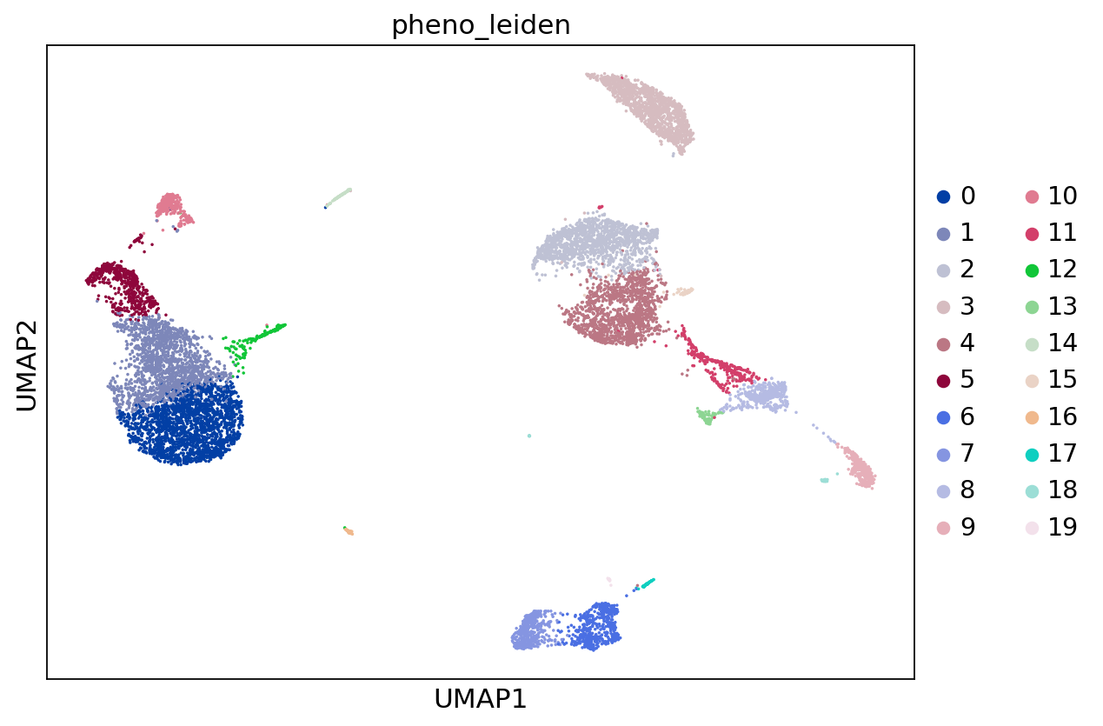
Diffusion Maps

Slide 14
Current data has more distinct clusters

Slide 15
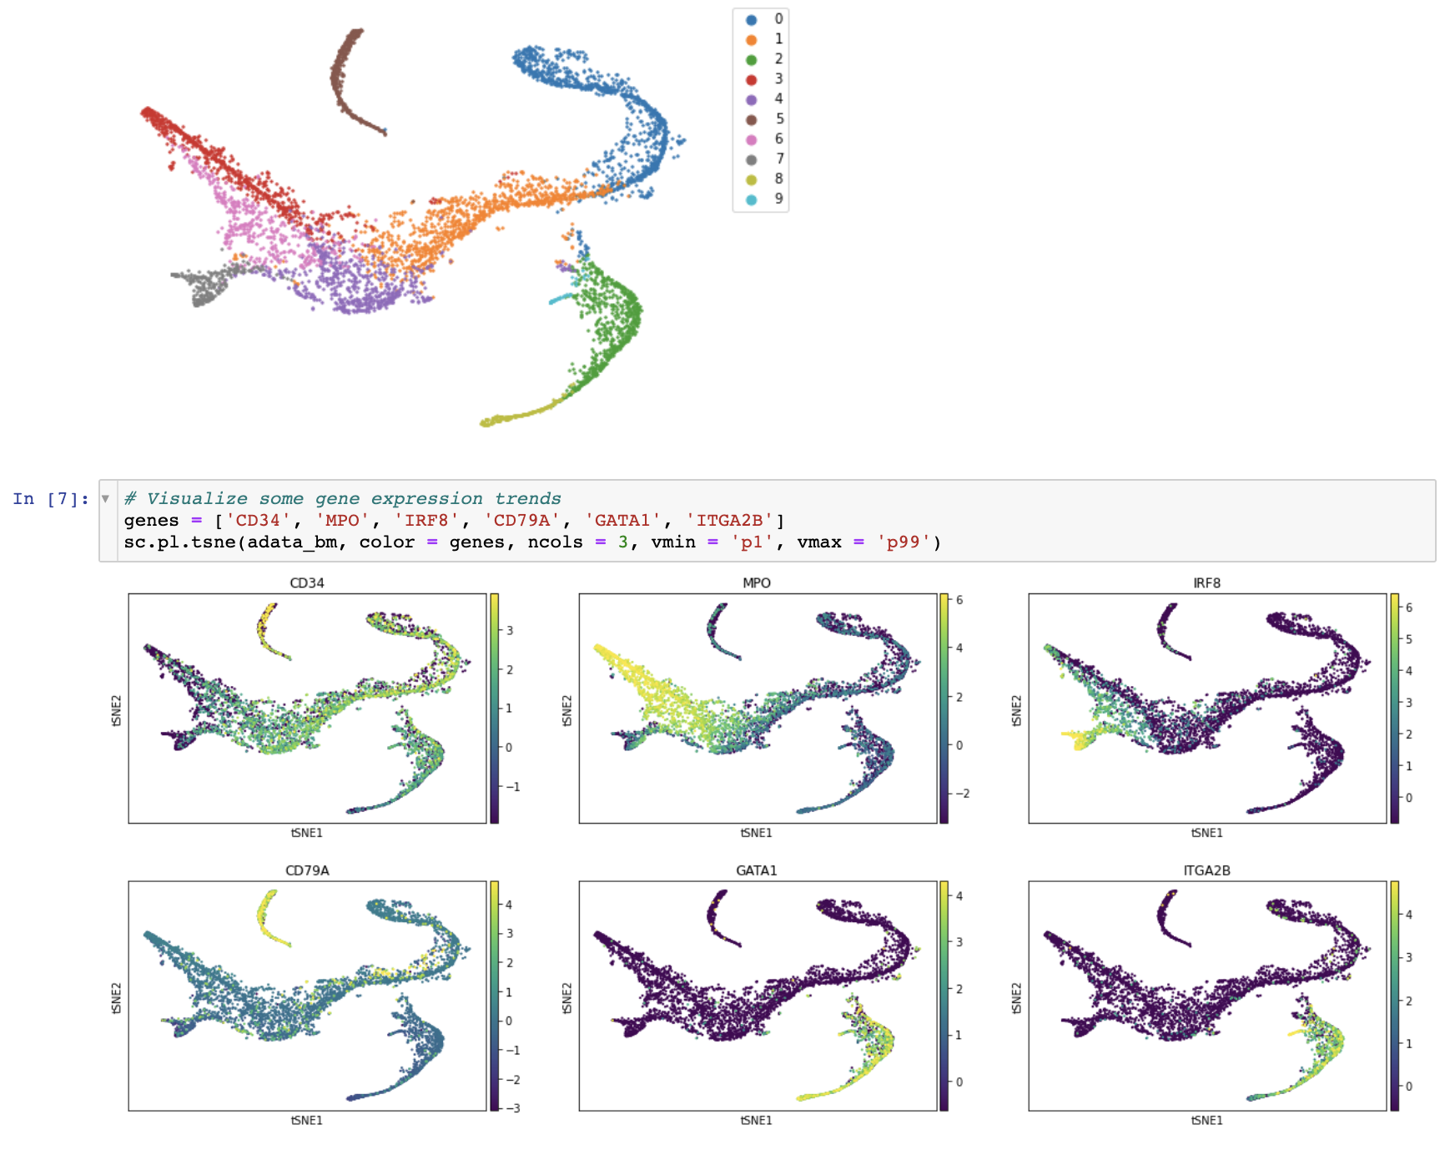
Switch to a more continuous data
CD34+ bonemarrow cells
Healthy, undergoing myeloid development
Ref: https://www.nature.com/articles/s41587-019-0068-4
Data ref: https://github.com/dpeerlab/Palantir

Slide 16
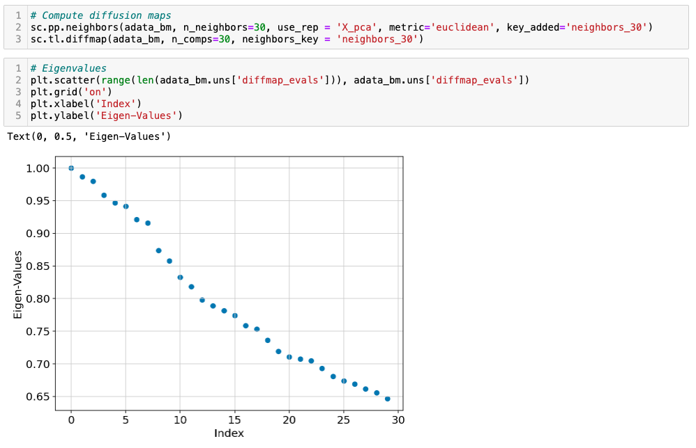
Diffusion Maps on a more continuous data
This dip suggests top 7 eigenvectors most informative!

Slide 17
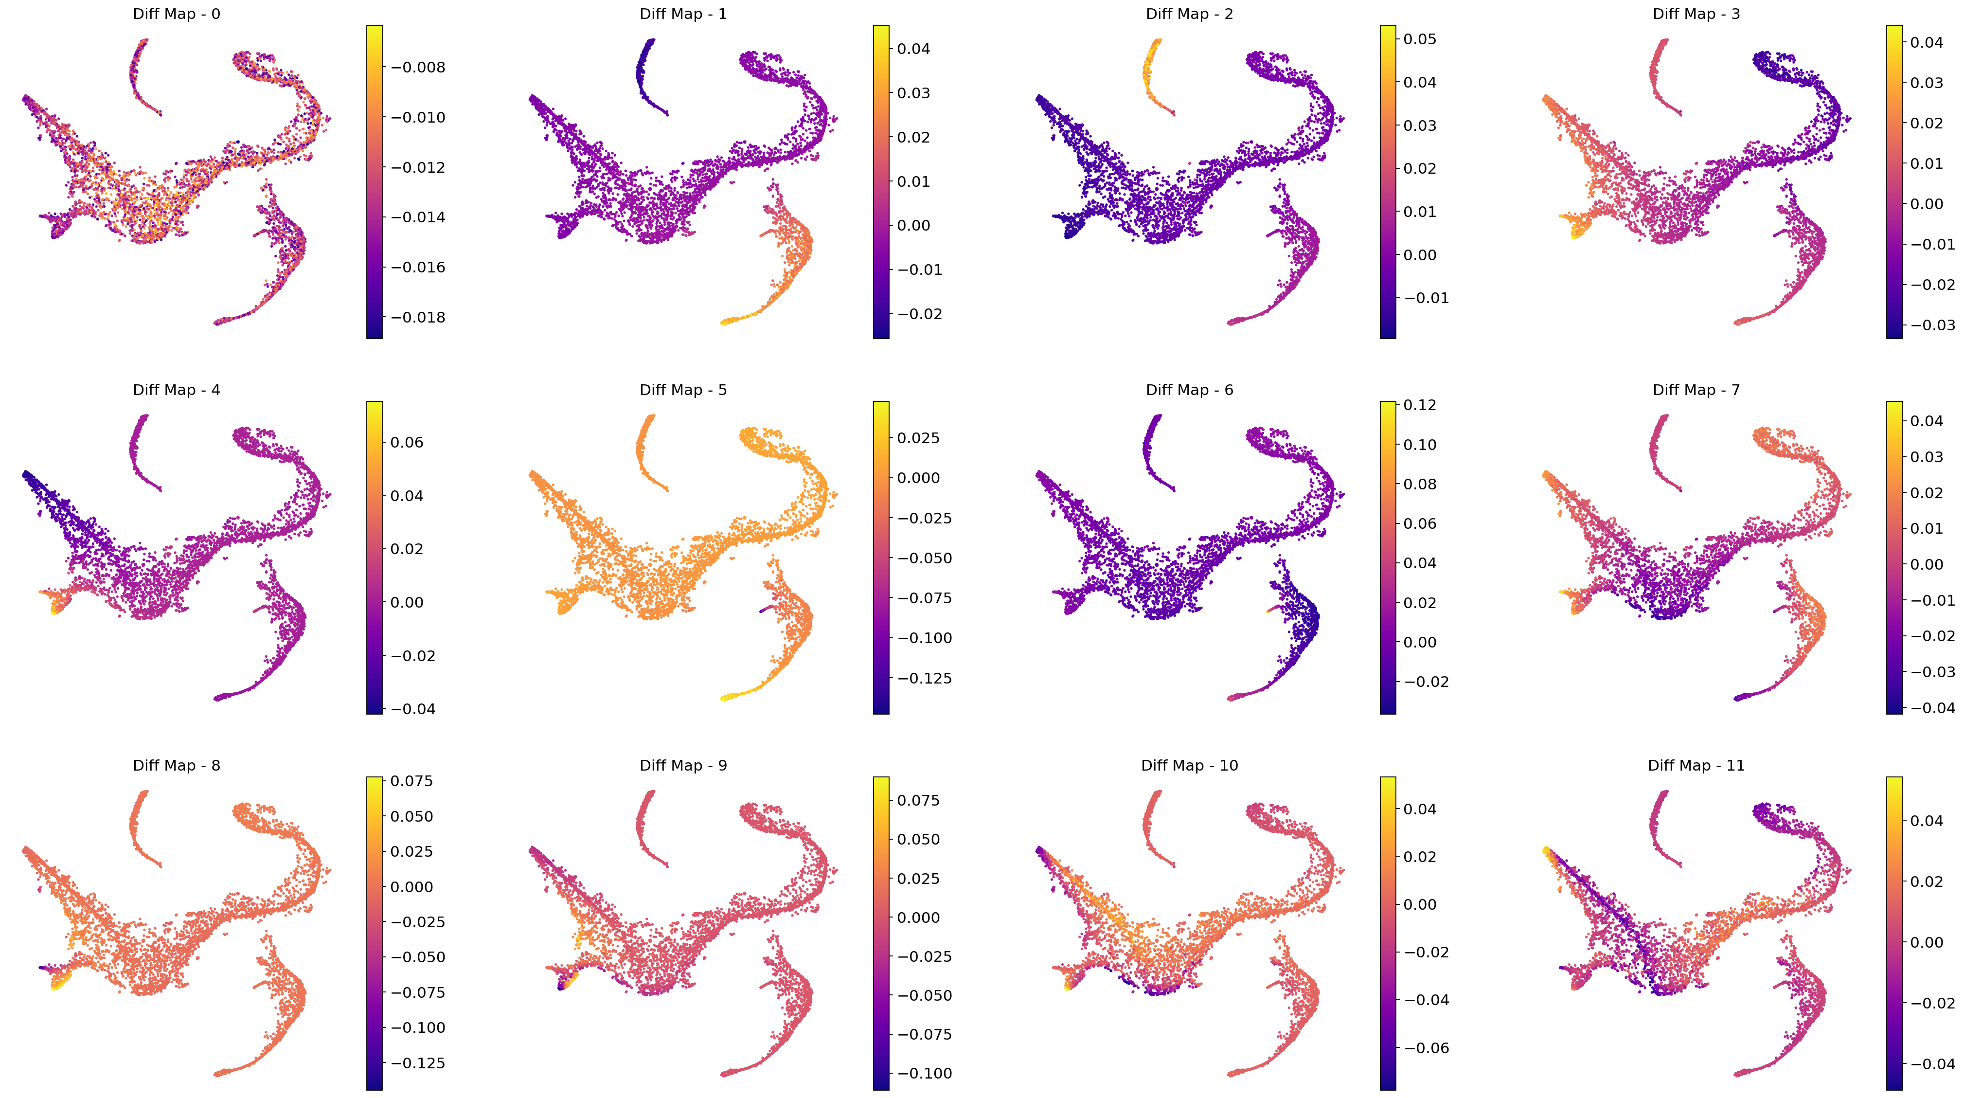
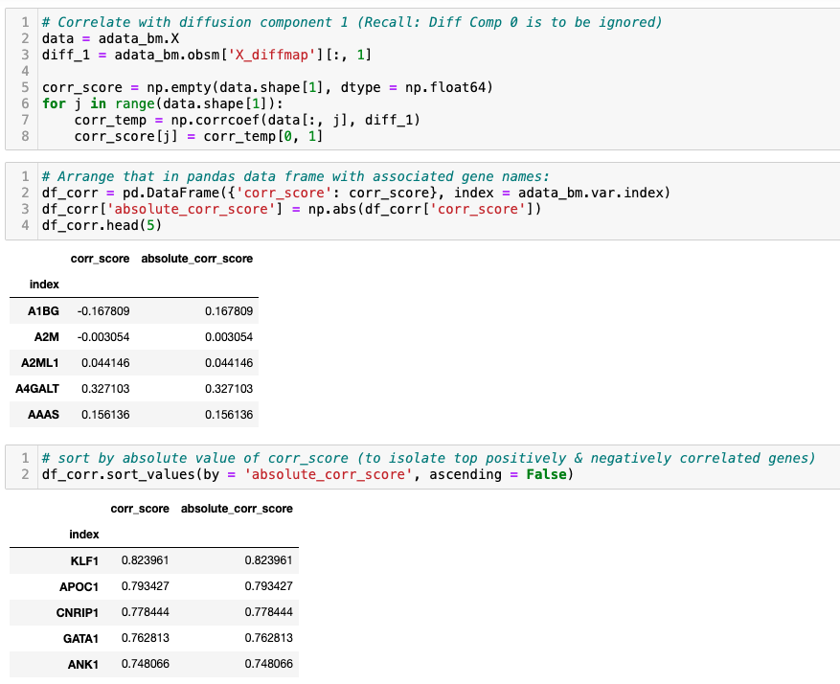
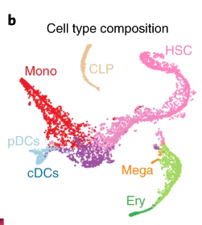
Diffusion Maps on a more continuous data

Slide 18
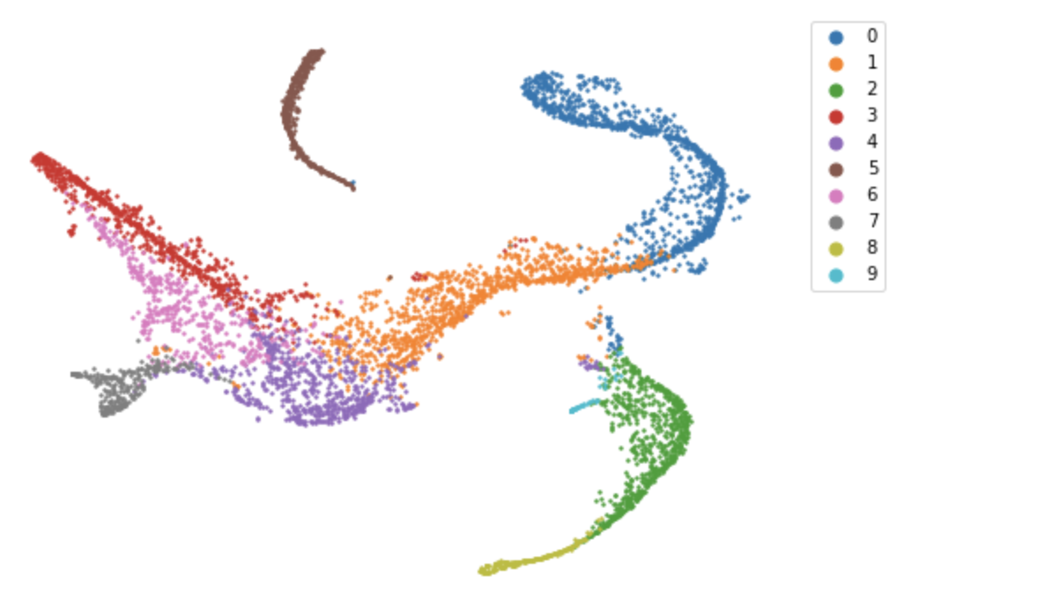
Diffusion Components: Application
Diffusion components are well suited to compute phenotype distances
For example: If we want to measure the distance between two cells, you can use Euclidean distance in the diffusion maps space.
But how many diffusion components to choose?
How to compute a unifying trajectory when you have many axes of variation?

Slide 19
Approach 2: Palantir

Slide 20
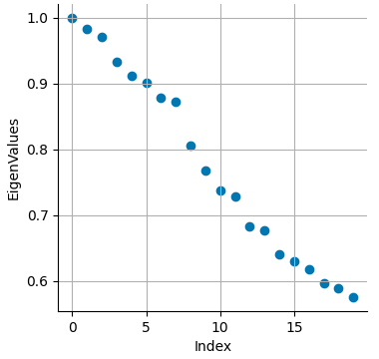
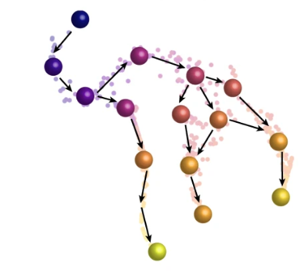
Diffusion components -> Palantir to align cells onto a trajectory
Transition Matrix
Gene5
PCA2
Gene4
Gene1
PCA1
Gene2
PCA3
Gene3
Diffusion Component 2
Rescale
Compute distances here and align cells from a start cell
Diffusion Component 1
Notes:
Can interpret every entry of the resulting matrix as the transition probability of a random walker.

Slide 21
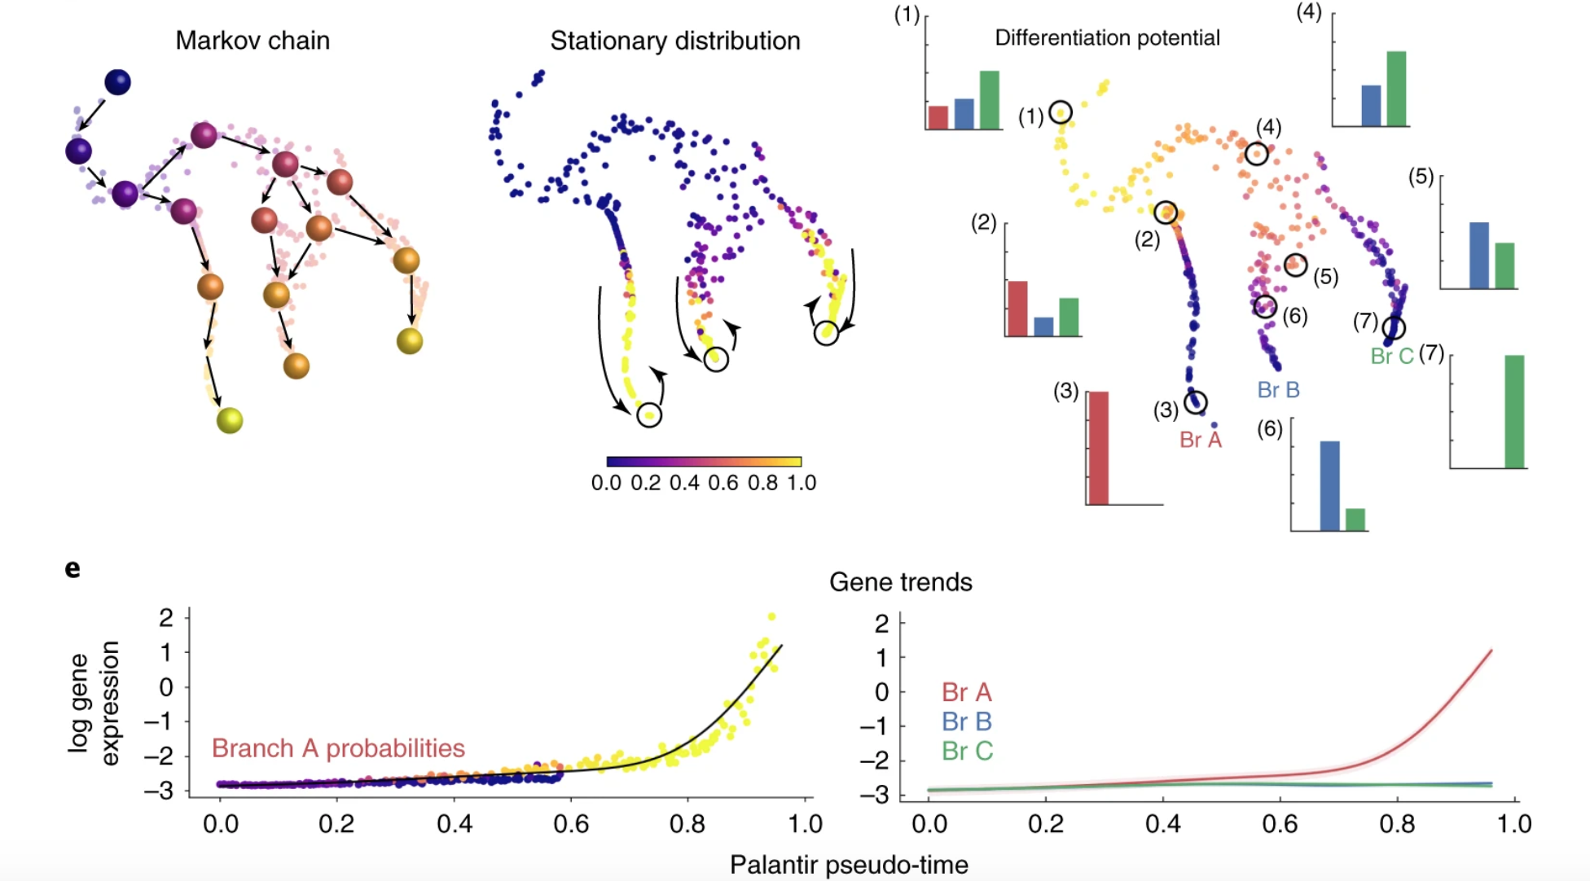
Diffusion components -> Palantir to align cells onto a trajectory
Notes:
Can interpret every entry of the resulting matrix as the transition probability of a random walker.

Slide 22
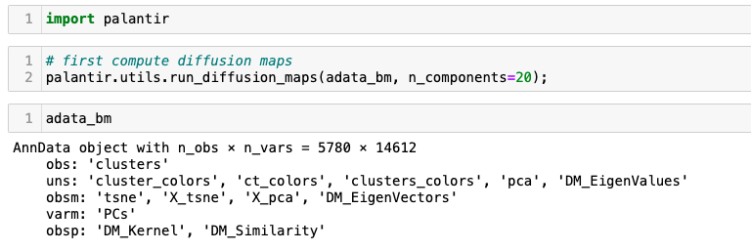
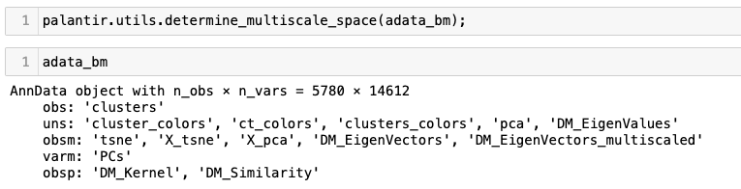
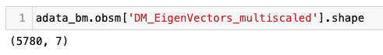
Palantir from multiple diffusion components

Slide 23
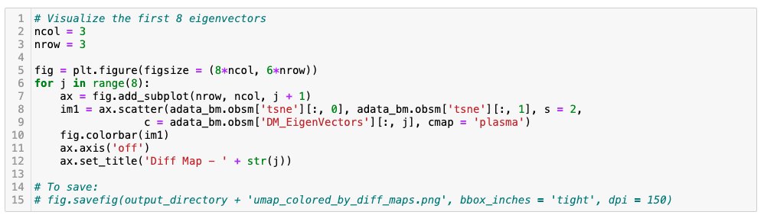
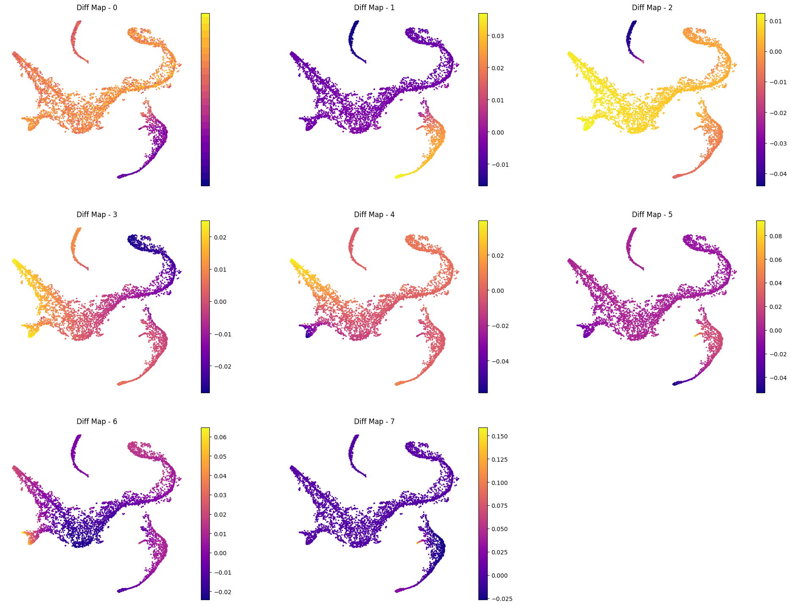
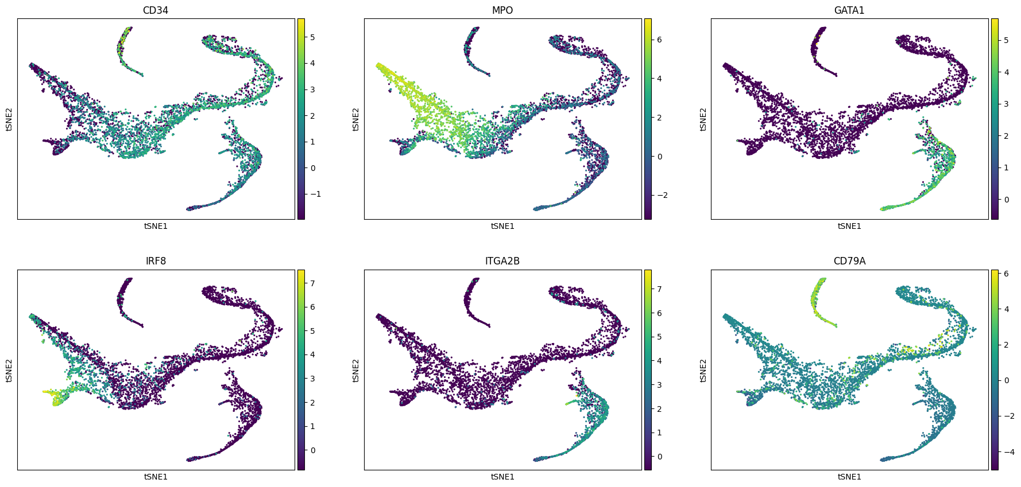
Palantir from multiple diffusion components

Slide 24
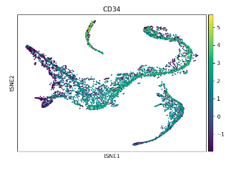
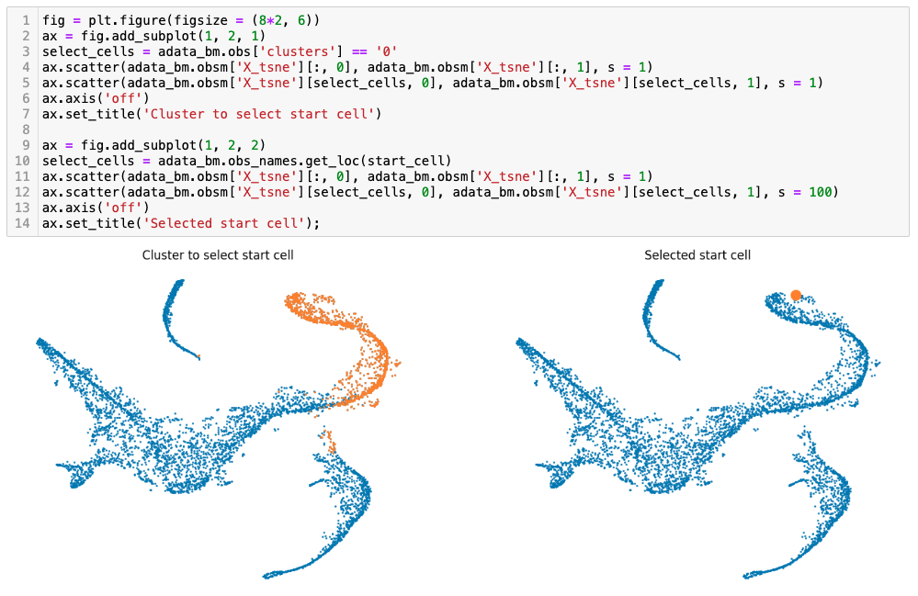
Step 1: Define start cell

Slide 25
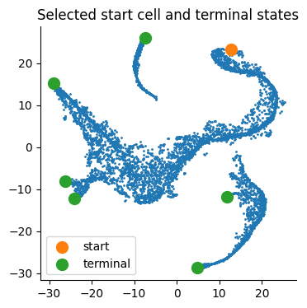
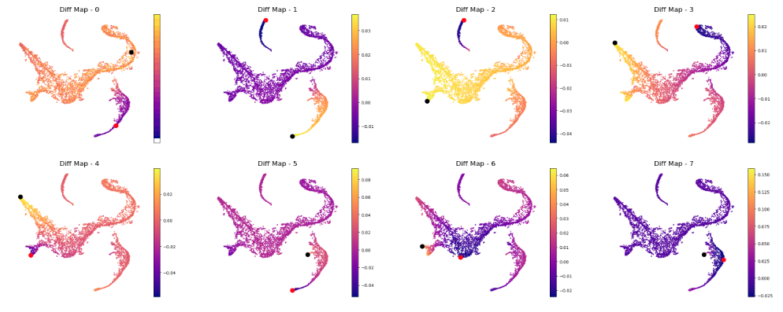
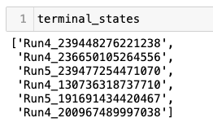
Step 2: (Optional) Define terminal states

Slide 26
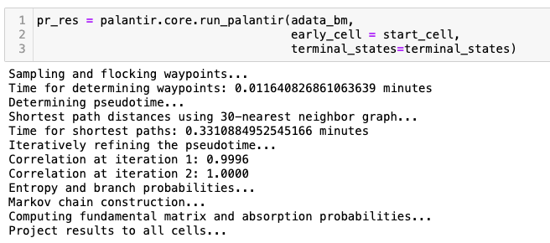
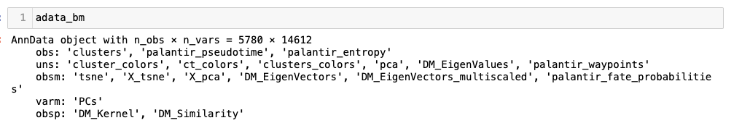
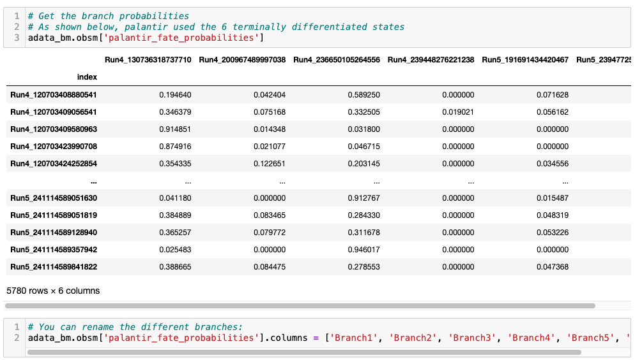
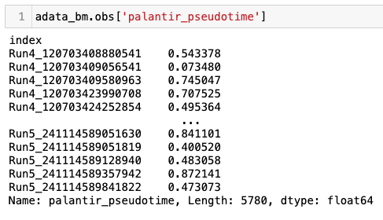
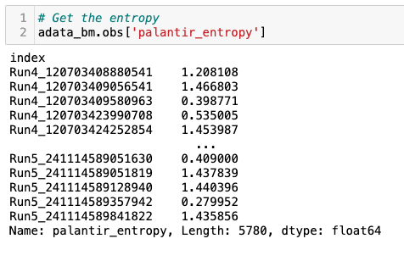
Step 3: Compute pseudotime

Slide 27
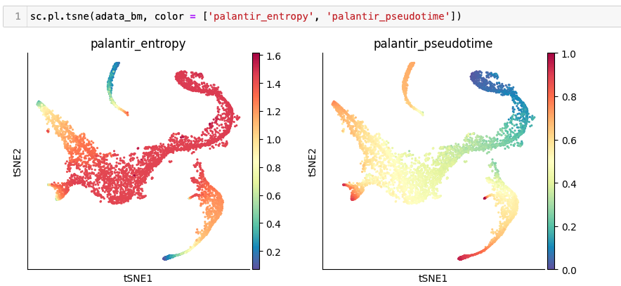
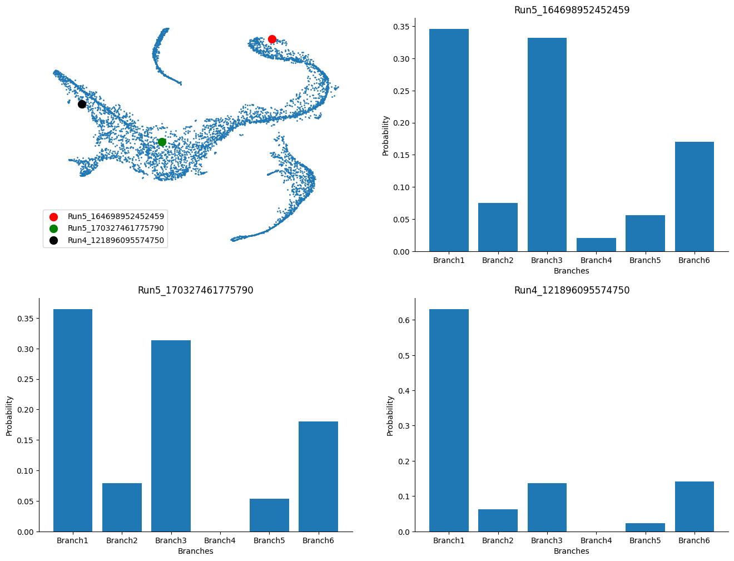
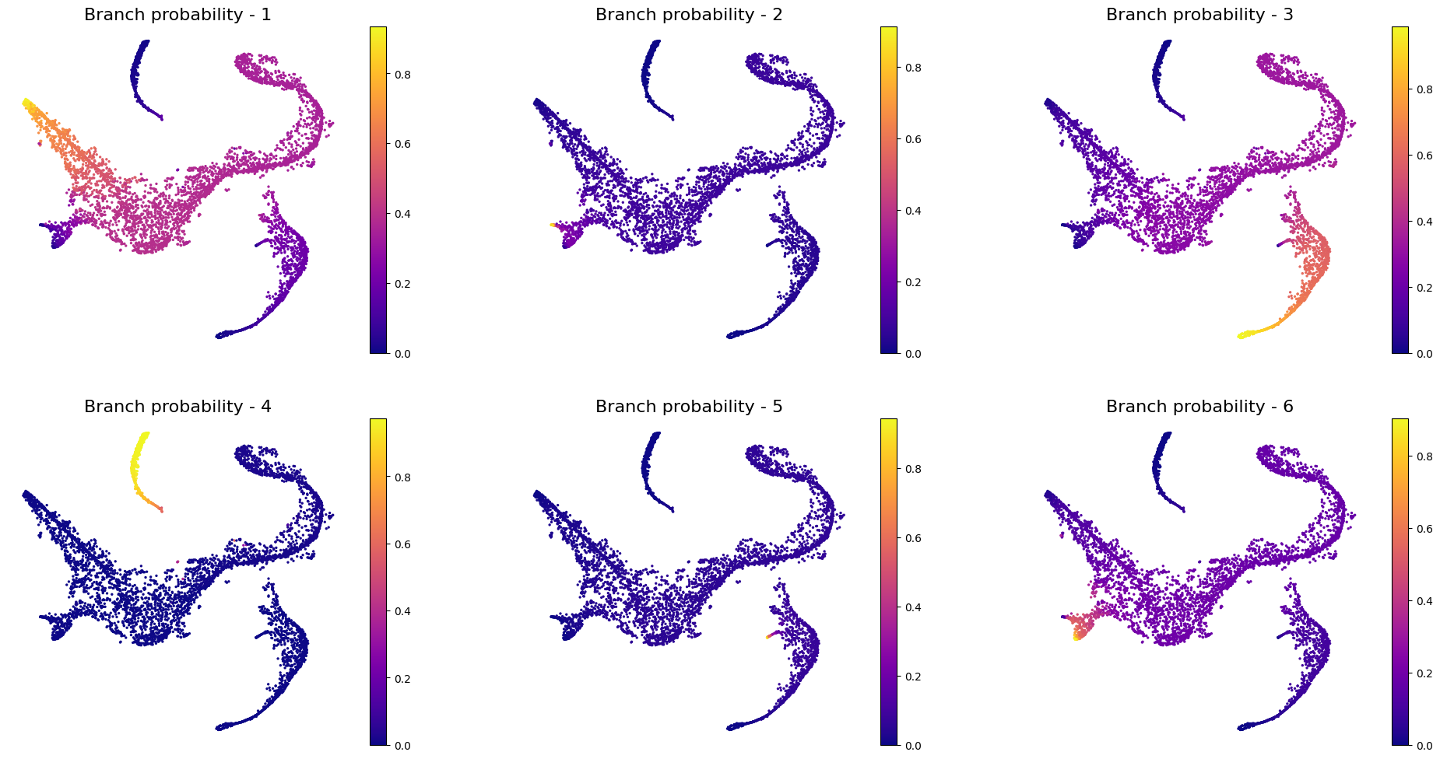
Visualize

Slide 28
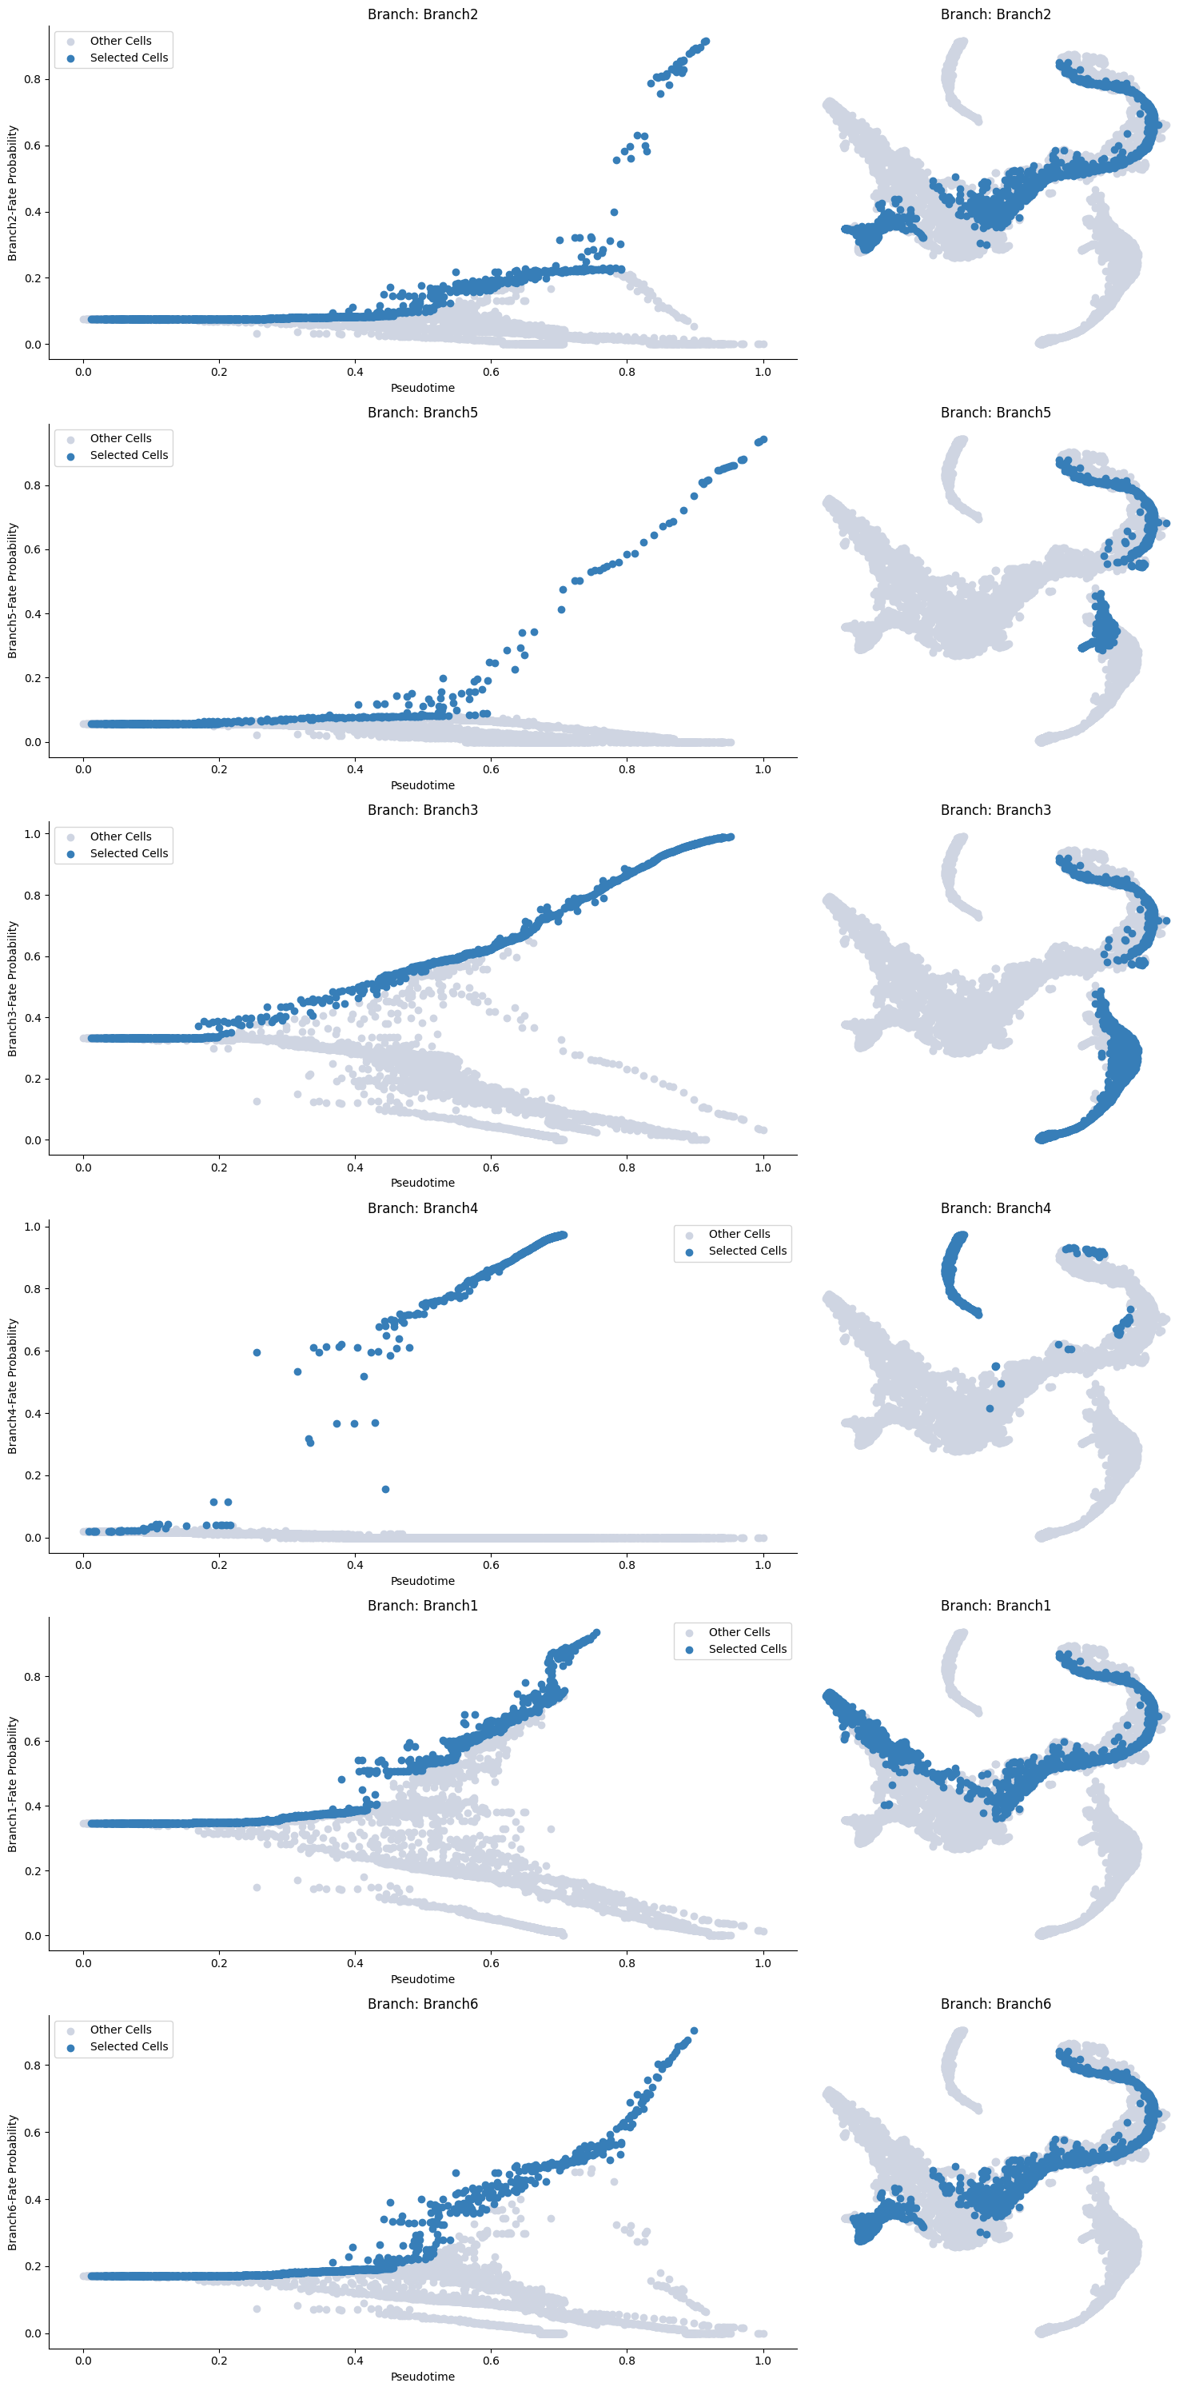
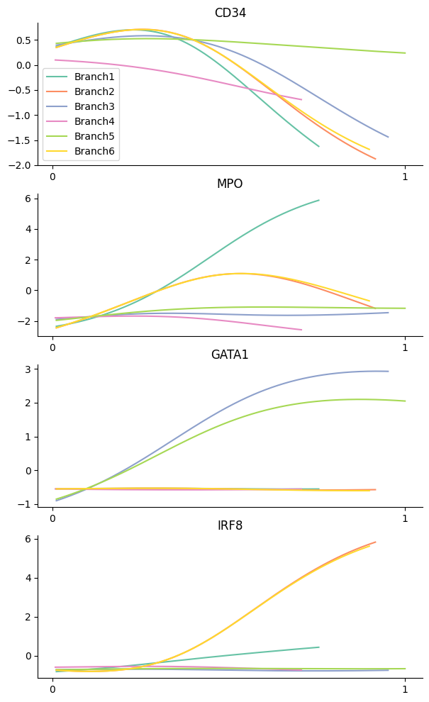
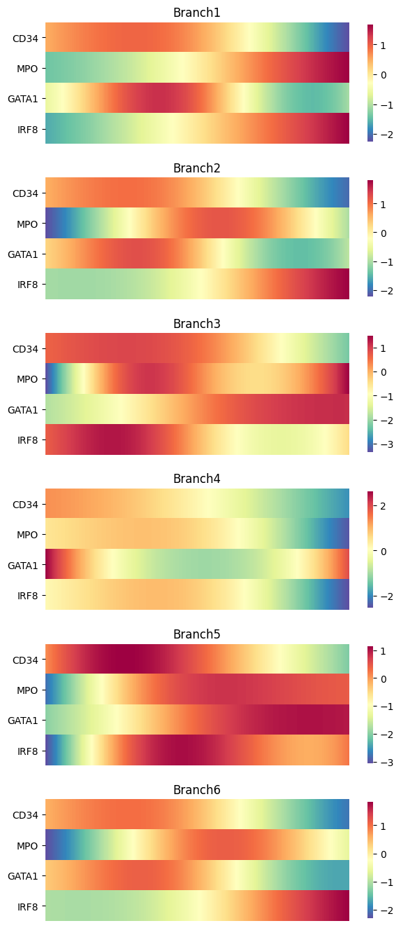
Visualize

Slide 29
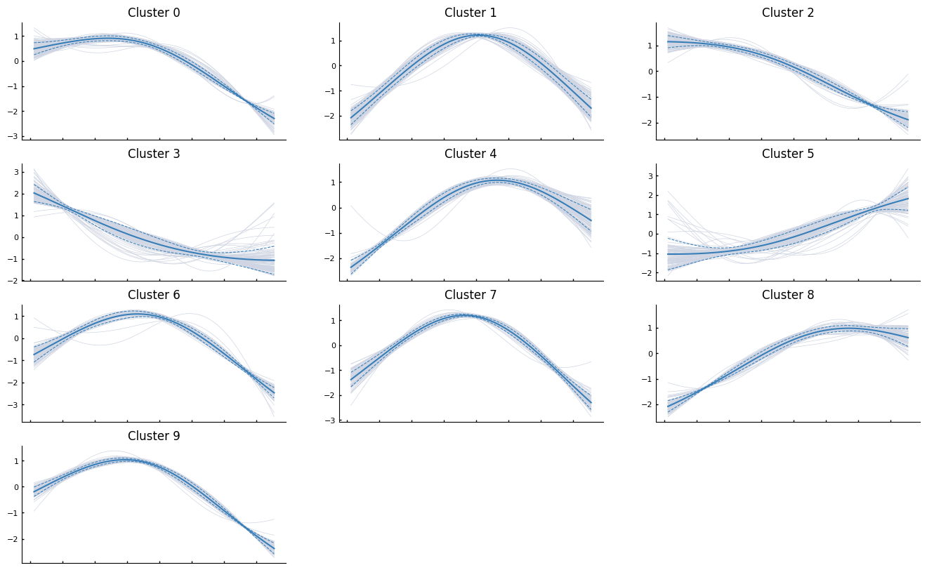
Grouping based on gene trends

Slide 30
Approach 3: PAGA

Slide 31
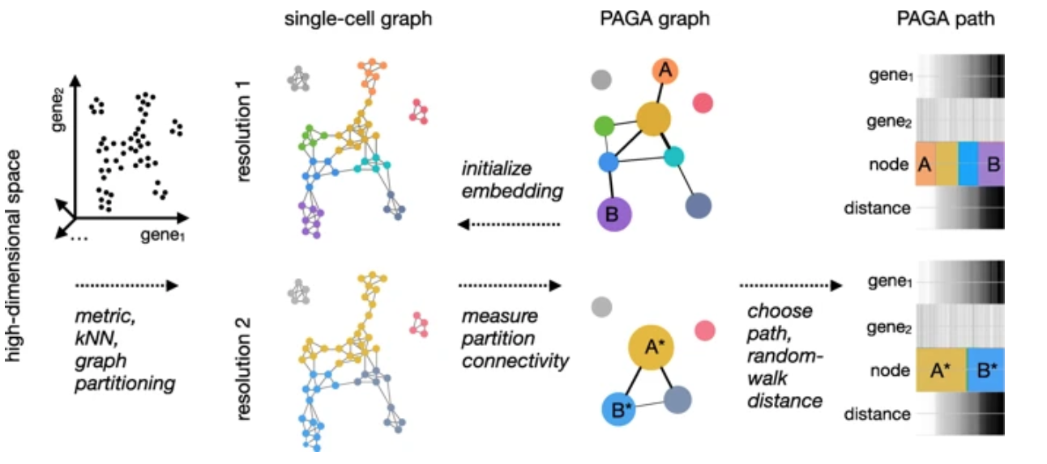
PAGA (Partition-based Graph Abstraction)
Often, studying cell differentiation process using pseudotime may not be optimal due to issues resulting from inadequate sampling of cells. In such cases, the notion of connecting clusters of cells using graph-based metrics (to avoid errors that Euclidean distance might cause) has been proposed as an alternative

Slide 32
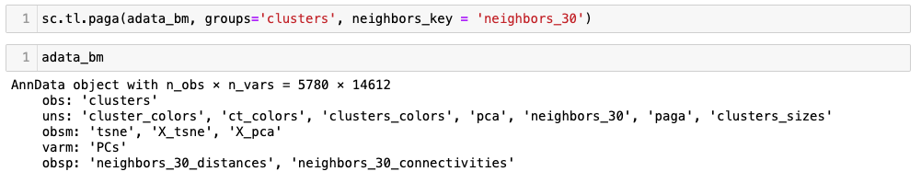
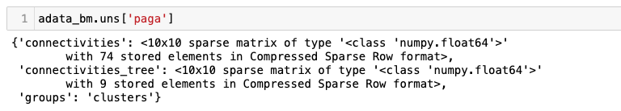
PAGA on Scanpy using PCA distances

Slide 33
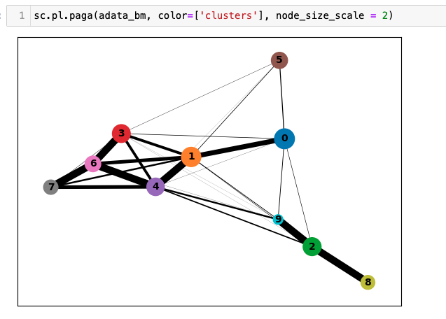
PAGA on Scanpy using PCA distances
Interpreting the plot above:
Each circle indicates a cluster, and the size of the circle is proportional to size of the cluster.
Two circles that are phenotypically close to each other - as quantified by the distances computed on the PCA space - are connected to each other.
The width of the connecting edges is proportional to the similarity between the clusters.

Slide 34
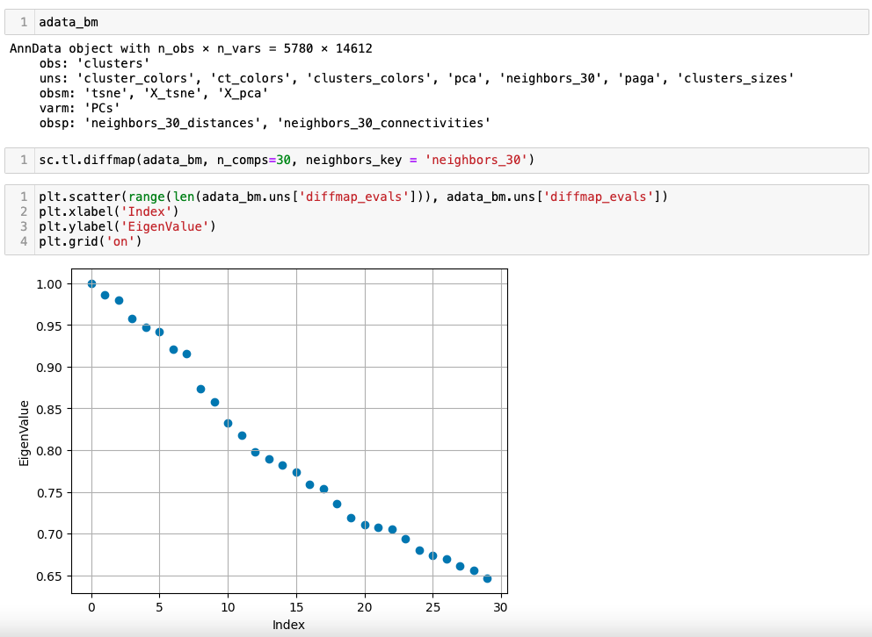

PAGA on Scanpy using diffusion distances

Slide 35

PAGA on Scanpy using diffusion distances
Interpretations example:
Cluster 9 is ITGA2B+ (Megakaryocytes) and it is more phenotypically closer to cluster 2 and 8 as opposed to clusters 1 and 4.

Slide 36

PAGA on Scanpy – PCA vs Diffusion Components
Distances on Diffusion Components
Distances on PCA
Observation:
Cluster 9 is ITGA2B+ (Megakaryocytes) and it is more phenotypically closer to cluster 2 and 8 as opposed to clusters 1 and 4.
Diffusion distance based PAGA captures this more accurately than PCA based PAGA.
Notes:
Can interpret every entry of the resulting matrix as the transition probability of a random walker.

Slide 37

Using PAGA to get phenotype distances
Notes:
Can interpret every entry of the resulting matrix as the transition probability of a random walker.

Slide 38


Using PAGA to get phenotype distances
Notes:
Can interpret every entry of the resulting matrix as the transition probability of a random walker.

Slide 39
Recap
Library size distribution; Number of uniquely expressed genes per cell
scRNA-seq data matrix
Pre-process and QC
Number of cells each gene is expressed in
Visualization: tSNE, UMAP, Force Directed Layout
MT-content
Doublet Detection
Clustering: PhenoGraph, Leiden
Graph
PCA, dimensionality reduction
Data Normalization (Median library size + log transformation)
Imputation
Differential Expression, GSEA
Trajectory Inference
Factor Analysis, Multisample Analysis, Batch Effect Correction

